Slide 1

K-Means & DBSCAN Algorithm Artificial Neural Networks
R Bharath

Slide 2


Supervised learning
Training set:

Slide 3
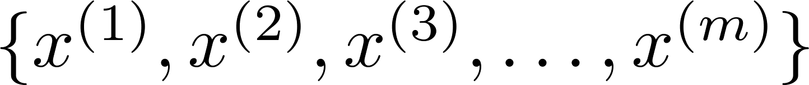
Unsupervised learning
Training set:

Slide 4


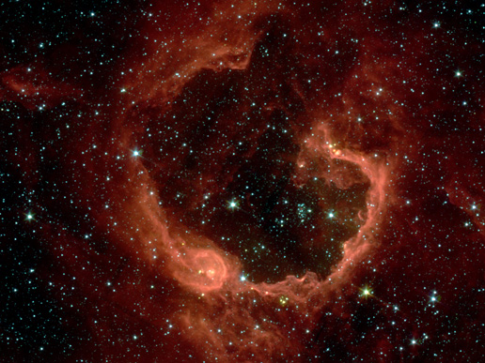
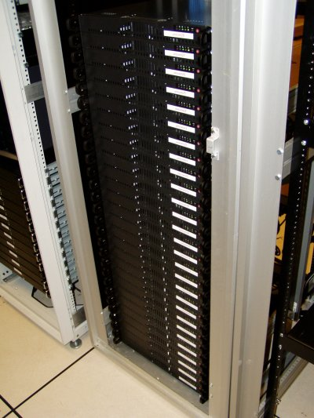
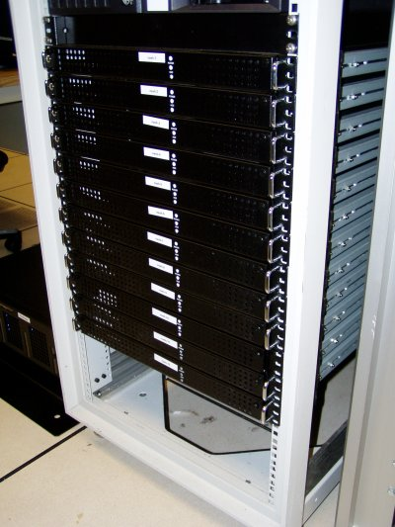
Applications of clustering
Market segmentation
Social network analysis
Image credit: NASA/JPL-Caltech/E. Churchwell (Univ. of Wisconsin, Madison)
Organize computing clusters
Astronomical data analysis
Notes:
Swap: market seg and organize clusters

Slide 5
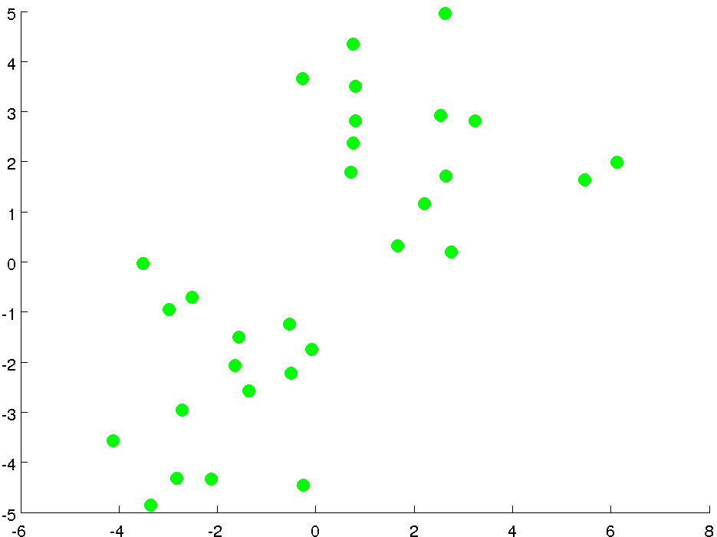

Slide 6
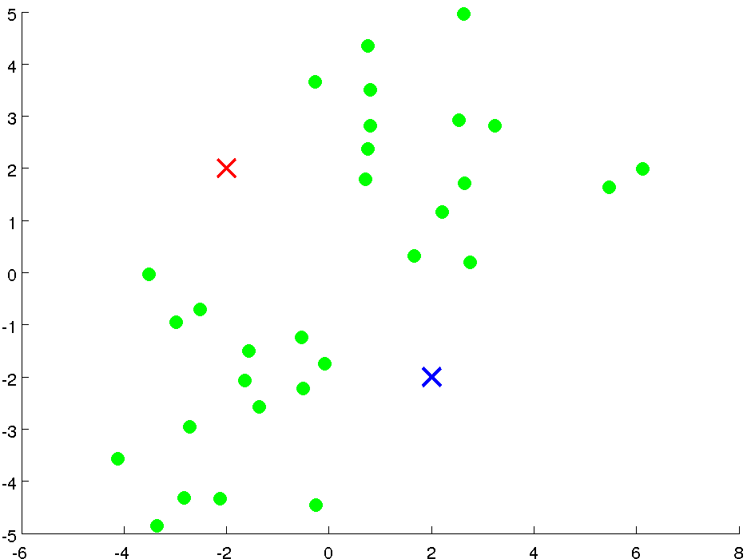

Slide 7
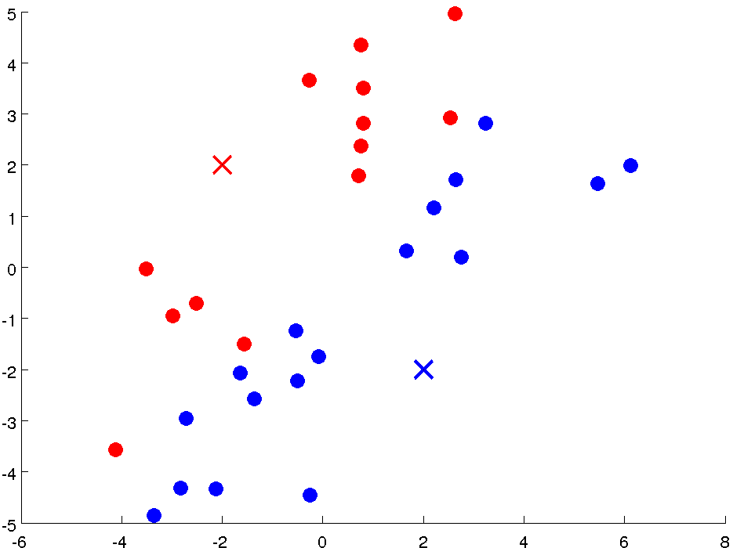

Slide 8
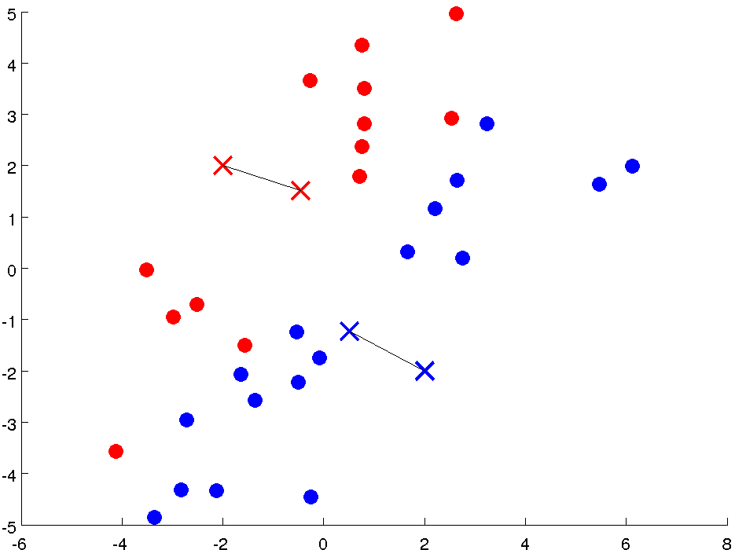

Slide 9
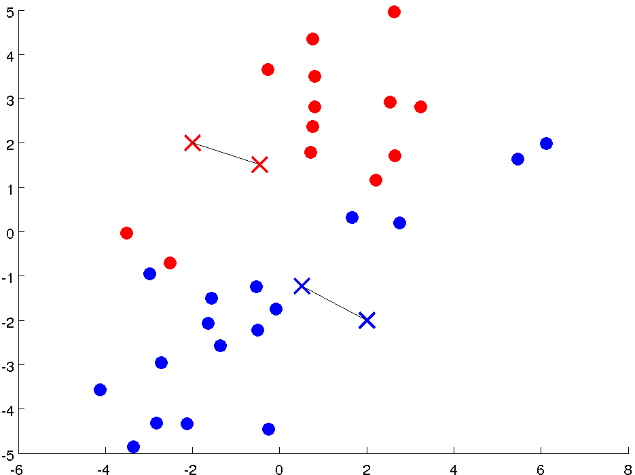

Slide 10
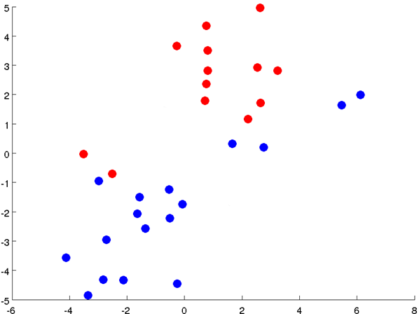

Slide 11
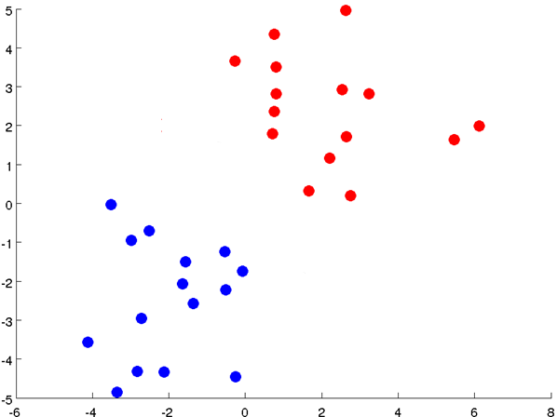

Slide 12
Notes:
Get rid of the legacy points

Slide 13
Notes:
Get rid of the legacy points

Slide 14

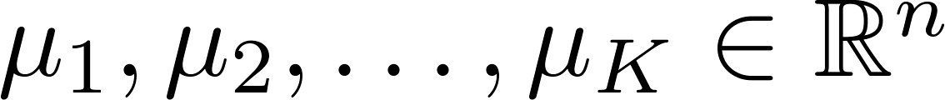
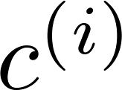
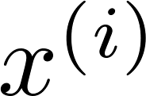

K-means algorithm
Randomly initialize cluster centroids
Repeat {
for = 1 to
:= index (from 1 to ) of cluster centroid
closest to
for = 1 to
:= average (mean) of points assigned to cluster
}
Notes:
Replace with normal text, size with LATEX fonts

Slide 15
Drawbacks
Need to specify the Cluster Size
Sensitive to Noise
The performance varies with the initialization

Slide 16
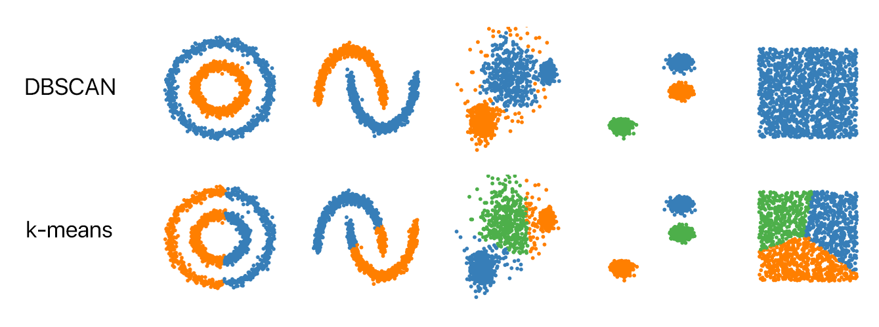

Slide 18
DBSCAN
Density based Spatial Clustering of Applications in presence of Noise

Slide 19
Working of DBSCAN
DBSCAN algorithm requires two parameters:
eps: It defines the neighborhood around a data point i.e. if the distance between two points is lower or equal to ‘eps’ then they are considered neighbors.
MinPts: Minimum number of neighbors (data points) within eps radius.
As a general rule, the minimum MinPts can be derived from the number of dimensions D in the dataset as, MinPts >= D+1.

Slide 20
Density-based spatial clustering of applications with noise (DBSCAN)
Algorithmic steps for DBSCAN clustering
The algorithm proceeds by arbitrarily picking up a point in the dataset (until all points have been visited).
If there are at least ‘minPoint’ points within a radius of ‘ε’ to the point then we consider all these points to be part of the same cluster.
The clusters are then expanded by recursively repeating the neighborhood calculation for each neighboring point

Slide 21
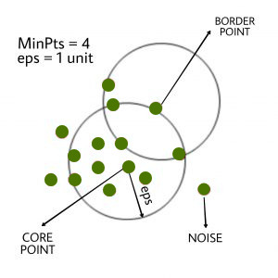
About Data Points
In this algorithm, we have 3 types of data points.
Core Point: A point is a core point if it has more than MinPts points within eps.
Border Point: A point that has fewer than MinPts within eps but it is in the neighborhood of a core point.
Noise or outlier:
A point that is not a core point or border point.

Slide 23
DBSCAN()

